Slide 1
A reminder about the Trapezium Rule
We cannot always integrate a function exactly.
When this happens we need an approximate solution.
This is what we use the trapezium rule for.

Slide 2
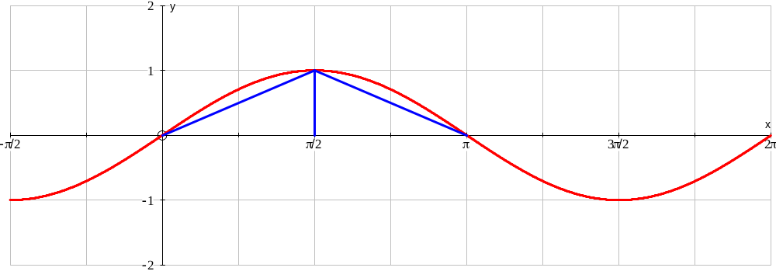
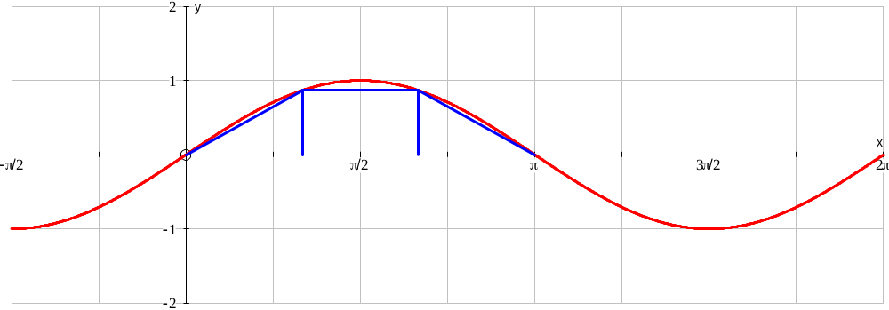
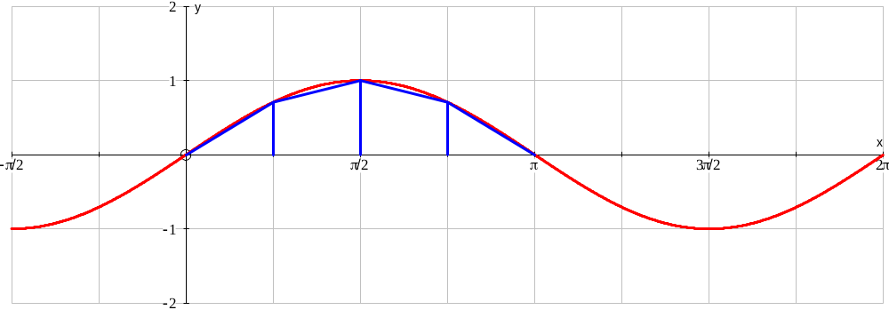
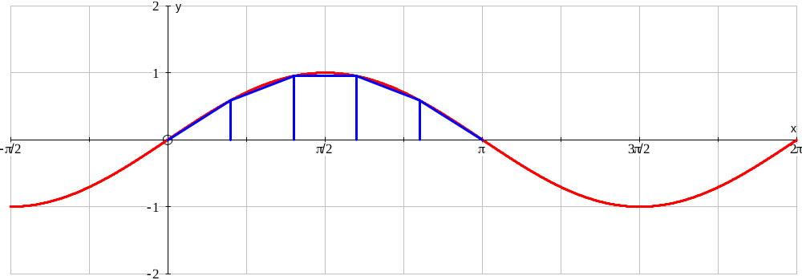
The trapezium rule
The trapezium rule allows us to estimate the area under a curve by using trapeziums to approximately fill the space.
The more trapeziums we use the better the approximation

Slide 3
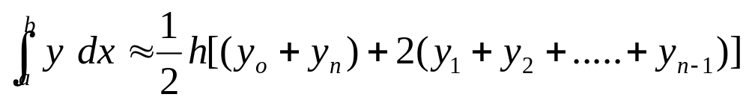
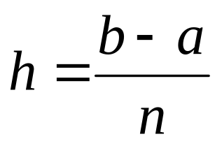
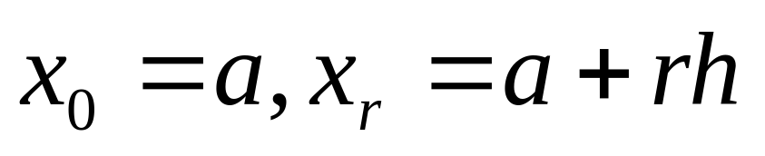
The trapezium rule
The trapezium rule states that:
Where

Slide 4
Simpson’s Rule
Simpson’s rule is similar to the trapezium rule.
Except instead of using straight edges to approximate the curve it uses a parabola

Slide 5
Simpson’s Rule
If we know 3 points on a curve we can construct the equation of a quadratic equation that passes through all three points
For example:
A curve passes through (0,3),(1,12) and (3,42)

Slide 6
Simpson’s Rule
When we are asked to integrate we are given 2 points as the end points of our integral. We can use these and the mid point between these points to give us the 3 points we need to form a quadratic equation passing through at least these 3 points.

Slide 7
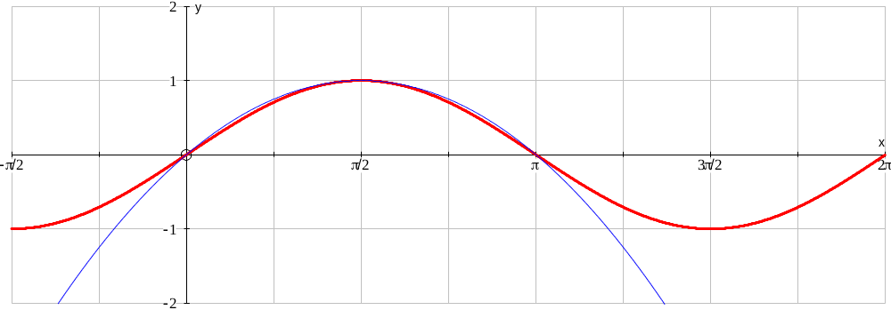
Simpson’s Rule
We can then integrate this quadratic to give us an approximation for the integral we are looking for

Slide 8
Simpson’s Rule
You will be pleased to know that you don’t have to find equivalent polynomials to be able to use simpson’s rule!!!!

Slide 9
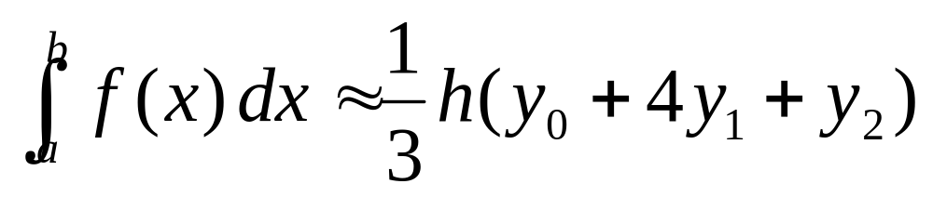
Simpson’s Rule
Simpson’s Rule is defined as:
Where b-a = 2h

Slide 10
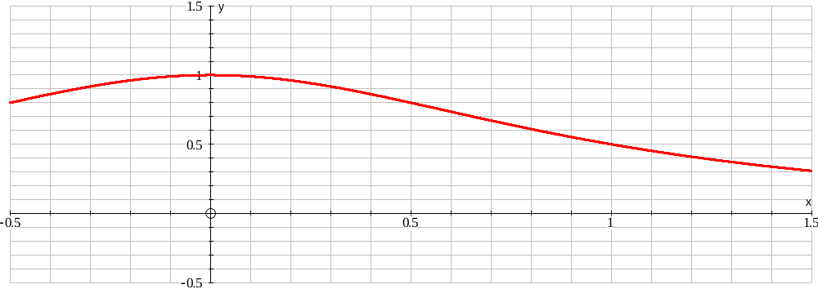
Simpson’s Rule
We can make the estimates more accurate as with the trapezium rule by using sub intervals within the main interval

Slide 11
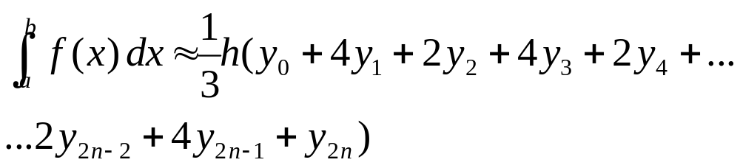
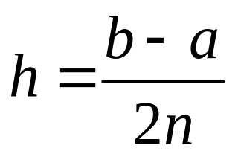
General Form of Simpson’s Rule
With 2n intervals (or 2n+1 ordinates) is
Where

Slide 12
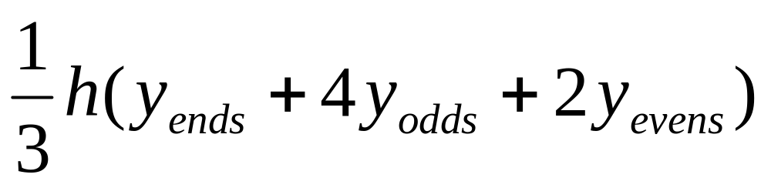
Simpson’s Rule
Or perhaps a little easier to remember …..

Slide 13
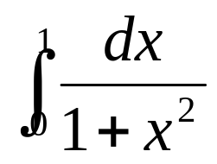
Simpson’s Rule
Eg. Use simpson’s rule with 4 intervals to approximate
n
x_{n}
y_{n}
Sum
Weight
Total
Ends
0
0
1
4
1
0.5
1.5
x 1=
1.5
Odds
1
0.25
0.9411765
3
0.75
0.64
1.5811765
x 4=
6.3247059
Evens
2
0.5
0.8
0.8
x 2=
1.6
9.4247059

